Slide 1
Inductive Bible Study - O.I.A. Example -

Slide 2
Observation
Write out the Passage

Slide 3
Observation
Start by gathering context!

Slide 4
Observation
Start by gathering context!

Slide 5
Observation
Note the immediate context

Slide 6
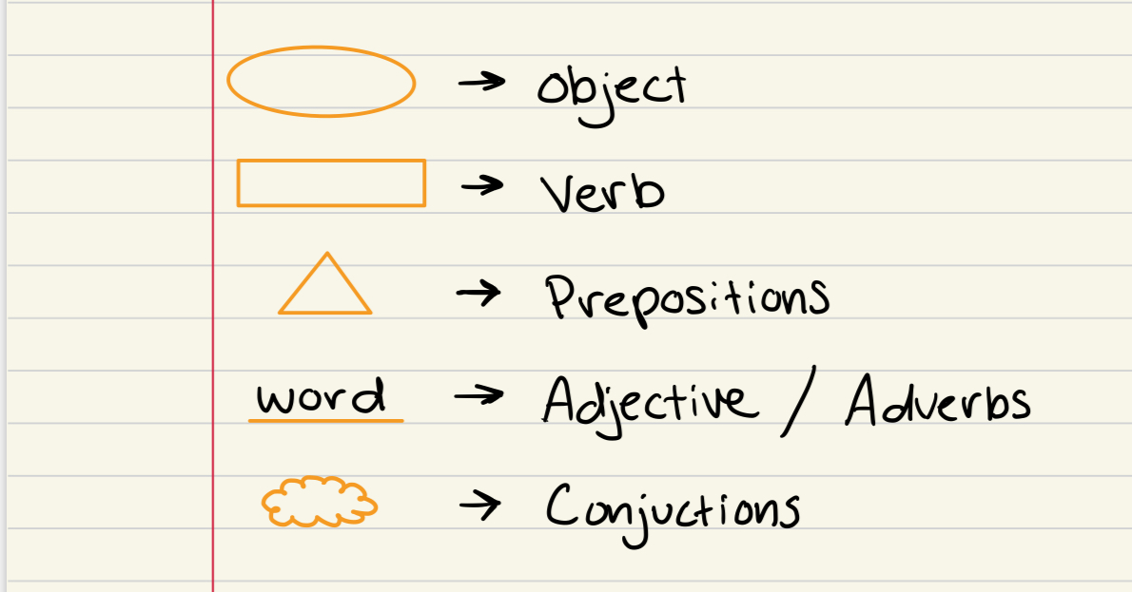
Observation
Note the grammar first!

Slide 7
Observation
Note the grammar first!

Slide 8
Observation (Cont.)
What do we see?

Slide 9
Interpret
- Put the pieces together -

Slide 10
Interpret
- Put the pieces together -

Slide 11
Interpret
- Put the pieces together -

Slide 12
Interpret
- Put the pieces together -

Slide 13
Interpret
- Put the pieces together -

Slide 14
Interpret
- Put the pieces together -

Slide 15
Interpret
- Put the pieces together -

Slide 16
Interpret
- Put the pieces together -

Slide 17
Interpret
- Put the pieces together -

Slide 18
Interpret
- Put the pieces together -

Slide 19
Interpret
- Put the pieces together -

Slide 20
Interpret
- Put the pieces together -

Slide 21
Interpret (Cont.)
Give a summary in your own words

Slide 22
Application

Slide 23
Free Study Resources

